Slide 1

Santander UK Risk Appetite
Board Training
April 2012
Patricia Jackson Ernst & Young
Javier Munoz-Grandes Santander
Begoña Ramos Santander

Slide 2






1.1 What is Risk Appetite?
E
Risk Appetite
Level and type of risk that Santander UK is willing and able to accept in pursuit of its strategic objectives expressed in a business plan
Risk
The potential negative deviation to plan resulting from exposure to uncertainty
Buffer
The buffer should consider the possibility of very extreme outcomes and modelling error
Risk
Appetite
Risk Capacity
Maximum level of risk that Santander UK can assume given its capital and liquidity resources, its risk profile and obligations to stakeholders. Risk capacity is a maximum which is not necessarily intended to be reached

Slide 3
1.3 Regulators expectations on Risk Appetite
E
  Following the financial crisis, regulators globally have substantially increased their focus on Risk Appetite.
  Regulators are looking for firms to be able to demonstrate clearly that their Risk Appetite sets the “tone from the top” and it is effectively embedded into the everyday management of the business
  The Senior Supervisors Group (SSG) has released a series of reports with guidelines in this area since the crisis, that can be summarised as follows:
Risk Appetite is a common language across the firm – expressed through qualitative statements and appropriately selected risk metrics.
The firm’s Risk Appetite should be connected to the firm’s overall business strategy, liquidity, funding and capital plans.
It establishes an explicit, forward looking view of the desire risk profile in a variety of scenarios.
It is Board’s responsibility to approve and oversee the implementation of overall risk’s strategy, with an active an iterative process of review.*
* At least annually.

Slide 4




1.3 Regulators expectations on Risk Appetite
Senior Supervisors Group 2009
IIF Recommendations
Evidence lacking to demonstrate the Board of Directors’ involvement in setting and monitoring adherence to firm’s risk appetite
Suitably wide range of quantitative and qualitative metrics need to be used
Feasible remediation actions need to be established and included in the RAF for events such as loss of capital or a breach of limits
Boards need to clearly articulate individual risk limits and express the sum of these limits as an overall risk appetite
Risk appetite should be linked to strategy development & business plans
RAFs calls for the use of extensive judgment
Stress testing and scenario testing should form part of the RAF
Clarity regarding the ownership of risk is essential
Strong communication is essential for successful implementation.
Broad and multidimensional indicators of risk should be used by firms
A strong risk culture is a prerequisite to delivering an effective RAF
Senior Supervisors Group 2010
Ernst & Young findings
Embed RAF into day-to-day operations:
  Strong communication between CRO, Board, senior mgt, and business line leaders
  Accountability – performance incentives and business line constraints
Consistent language and metrics, both qualitative and quantitative, used across firm
Strong partnership between IT and business lines needed for implementation
Move to more automated process and less manual interventions to increase data reliability
Integration of disparate IT systems needed to provide accurate and comprehensive risk reporting
Firms still have significant way to go to close gaps between IIF and SSG recommendations and their RAF and governance
Durable improvements require deep change to embed RAF into day-to-day operations
Firms need to link risk appetite with stress testing and capital allocation
Requires strong involvement of the Board of Directors
Requires IT infrastructure to provide comprehensive and accurate data across firm
Firms need to establish their risk capacity as the maximum amount of risk that can be taken by a firm given its capital base, liquidity, borrowing constraints, regulatory constraints

Slide 5
1. | Introduction
1.1 1.2 1.3 1.4 | What is Risk Appetite? Lessons learnt from the Financial Crisis Regulators expectations on Risk Appetite Industry
2. | Santander UK current practice
2.1 2.2 2.3 2.4 2.5 2.5.1 2.5.2 2.5.3 2.5.4 2.5.5 2.6 2.7 2.8 | Weakness of the current approach Design Principles for SAN Risk Appetite Framework Structure of SAN UK Risk Appetite Exercise Risk appetite principles of Santander UK Definition of metrics Loss Capital Liquidity Qualitative Statements Concentrations Santander UK Risk Appetite metrics summary Governance Allocation of Loss
3. | Walkthrough of appetite setting
4. | Appendix A: Metrics definition
5. | Appendix B: Governance Process

Slide 6
2.2 Key Characteristics for SAN Risk Appetite Framework
  Following SSG guidelines and IIF recommendations Santander UK will design the new Risk Appetite
  Framework under the following characteristics:
All risk types must be considered
It is Board’s responsibility to approve and oversee the implementation of the Risk Appetite
It must reflect an aggregate view of the firm and clear application to individual businesses
Must be connected to overall business strategy, liquidity/funding and capital plan
It must be a forward looking process based on stress tests or scenario analysis
It cannot be static, as it must change as the business environment changes
It incorporates qualitative and quantitative statements
The assessment of the firm’s risk profile should be ongoing and iterative

Slide 7























2.3 Structure of Santander UK Risk Appetite Exercise
E
Risk Appetite principles
Business strategy and model
Financial objectives
Risk Management Principles
Framework & stress testing design
Design Principles
Metrics definition: primary, complementary and qualitative
Mechanism for allocating the appetite to business units and risk types
Linking the allocated appetite to the limit structures
Governance processes (linkage to strategic functions & stress testing framework)
ICAAP/ILAA
Operational Risk Scenarios
Historical data for benchmarking
Set the risk appetite
Propose the business plan
Management actions
Test the business plan vs. Risk appetite
Quantitative Statements
Qualitative Statements
Monitor performance vs. risk appetite
Monthly monitoring
Quarterly assurance
Ad-hoc challenge
Change the business plan
Introduce actions to mitigate breaches

Slide 8







2.4 Risk appetite principles of Santander UK
E
Business based
on commercial
activity
Maintain a predictable medium-low risk profile
Maintain a moderate market risk appetite
Maintain a policcy of stable profit generation and dividend pay-out
Preserve strong capital and liquidity ratios as an autonomous and self-sufficient subsidiary
Employment of a funding strategy that:
  Avoids excessive reliance on wholesale funding
  Provides effective diversification in the sources and tenor of funding.
Control large concentrations to single obligors and industries e.g. concentration framewo
Comply with an exceed all regulatory requirements e.g. conduct risk focus
Ensure adequate capital returns driven by a strong risk culture e.g. use of RORAC across the busines
Maintain the trust of its customers, shareholders, employees and business counterparties in its reputation and solvency.
Ensure that remuneration and incentives support the wider risk management and risk culture objectives.
Strong balance
sheet
Strong & effective
risk management

Slide 9

















E
2.5 Definition of Metrics
Operational Risk
Market Risk
Primary metrics
Articulate the risk appetite
Loss acts as the ‘lingua franca’ across risk types and business units
Subject to stress scenarios
Loss
Constructed from underlying P&L components
Capital
Regulatory & Economic Capital
Liquidity
Primary metrics
Complementary and qualitative metrics
Additional metrics to support the articulation of risk appetite i.e. concentration
Can be quantitative or qualitative
Monitoring metrics
Used in the day to day risk management and support Santander UK to deliver the Risk Appetite
Aligned to the appetite measures, but not part of the risk appetite statement
Other Risks
Credit Risk

Slide 10
2.6 Santander UK Risk Appetite Metrics
E
Loss
Capital
Liquidity
Complementary
Qualitative
Credit
Net Credit Losses
Common Equity Tier1 Ratio
Regulatory Capital Surplus
Economic Capital surplus
Coverage Ratio
Concentrations
NPL ratio
Net write-offs
Qualitative Statements
Market (Traded)
Mark to Market Risk P&L losses
Losses from risk factors (e.g. rates, equity, Credit)
Market (Non Traded)
Net interest margin
Economic Value Equity
Operational
Op. Risk Loss
N/A
Other non financial
Op. Risk Loss subcategory
Conduct statement
Pension
N/A
Deficit at risk
Required return per annum
Other
N/A
Internal Leverage Ratio

Slide 11
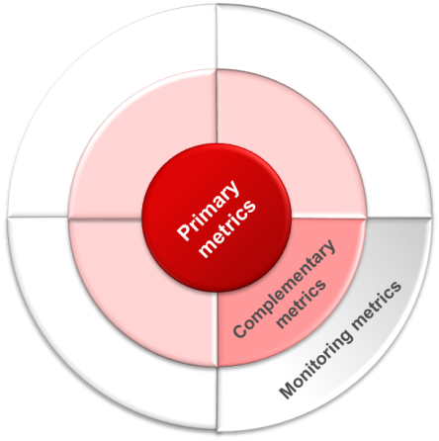










2.6.1 Santander UK Risk Appetite Metrics: Credit Risk example
Movement in balance sheet provisions + Gross Write off – Recoveries (where net basis of provision, + net write offs) – income adjustment + third party debt recovery costs
Based on realised losses, less subject to manipulation and removes the reliance on models that an Expected Loss measure would have
Net Credit Loss
Non Performing Loans
Complementary metrics support the primary metric by providing either a more forward looking view – e.g. Non Performing Loans or a wider context – e.g. Gross loss complements Net Credit Loss by removing the provision impact.
Gross Credit Loss
Concentrations
Monitoring metrics are aligned to the appetite measures and used by the business to manage to the appetite through day to day risk management activities
LTV
Arrears rates
VMG
Write-off Propensity

Slide 12
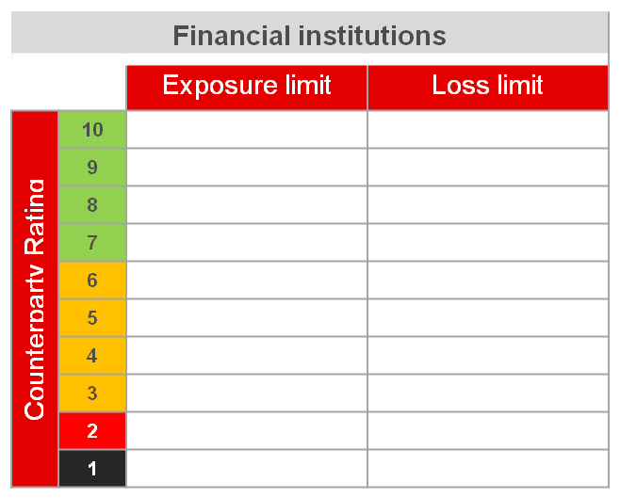

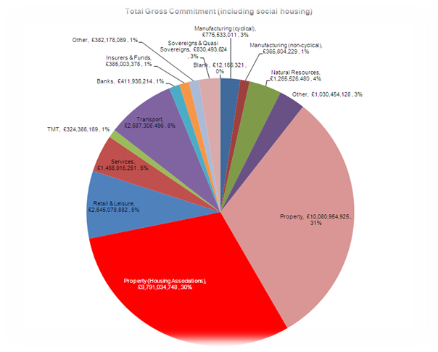
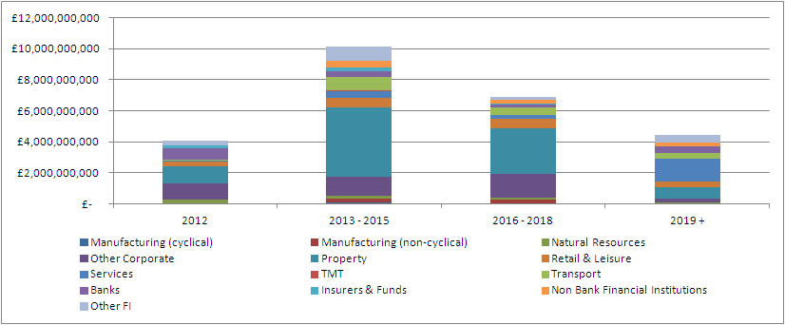
2.6.1 Santander UK Risk Appetite Metrics: Concentrations
Summary
Regulators are becoming increasingly prescriptive around concentration frameworks – both for single name concentrations and sector concentrations
As a result, Santander Group has undertaken an exercise to set stricter limits on concentrations, which Santander UK will align to
Single Name Concentrations
Single Name Exposure limits, tiered by credit rating
Corporate and FI exposures treated differently
Top 5 single name exposure reporting
Limit on the cumulative exposure to the Top 20
Sovereigns limit by country and rating
Sector Concentrations
Maturity
Exposures viewed by maturity
Particular emphasis on maturity concentrations within sector as this can amplify losses under stress
Structured approach to sectors – grouping together related industries, e.g. property and construction
Exposure limits on the % of total exposure to each sector
Underpinned by Sector appetite
Non UK Corporate exposure, with a sublimit for Peripheral Corporates

Slide 13














2.7 Governance
E
There are three main phases in the governance of risk appetite with six key underlying processes:
Proposed by the CEO with CRO agreement
Risk Oversight Unit provide challenge
Board Risk Committee reviews and recommends approval to the Board
Approved by the Board
Business Units propose plan
CRMO and Risk Oversight Unit test plan against appetite
Board Risk Committee reviews and recommends approval to the Board
Approved by the Board
Risk Oversight Unit monitors performance
Linked to Stress testing
Escalation to the Board Risk Committee and the Board as required
Roles and approvals
Framework design
Approval & allocation of Risk Appetite
Testing business plan against appetite
Monthly monitoring
Quarterly assurance
Ad-hoc challenge
1
3
4
Key Governance Processes *
5
2
6
* Refer to Appendix B for descriptions and process diagrams

Slide 14





























2.8 Allocation of appetite example: Credit Risk Loss
Board approval
Delegated authority from the Board to the CEO
CRMO & Internal Control Units
Risk Oversight function

